Slide 1



Slide 2
Seeing with My Father’s Eyes, Requires My Father’s Heart Darkness Lesson 21 – Covetousness
From Darkness to Light

Slide 3
Introduction
So why? Why do we sin? Having counted the cost, why would we choose to do what we know to be wrong? Why would we be willing to gamble so much for so little? Simply put, we make horrible trades.
When Potiphar’s wife tempted Joseph, a paraphrase of his response in Genesis 39:8-9 is:
“I’ve got almost everything; why would I trade all of that for the one thing I don’t have? Why would I trade this big thing for that small thing?”

Slide 4
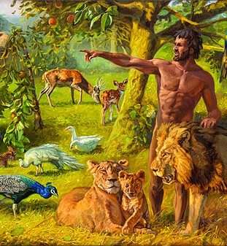
Introduction
If that sounds familiar, it should. Adam and Eve faced the same type of temptation in the Garden of Eden.
They had everything. They had it all.
Adam was the Joseph of God’s house.
He was in charge of naming all the animals (Gen 2:19)—an amazing honor.
Do you know how badly scientists desire to discover a new species and name it after themselves? Naming something is a high honor and that was Adam’s responsibility.
The Garden was theirs to live in and love.

Slide 5
Introduction
But then Satan came into the picture, and he did something to Adam and Eve that he has done for thousands of years.
He offered Eve a single piece of fruit when God had already given them an orchard.
Adam and Eve had the whole garden and traded it for a single piece of fruit.
Joseph had the entire household of Potiphar and was offered Potiphar’s wife.
And we, created in the image of God—invited to be representatives of His intentions for His glory on the earth—get tempted to trade it all for small and eternally insignificant things every day. It’s an “orchard-for-a-piece-of-fruit kind of trade.”

Slide 6

Introduction
Trading the beauty of God’s intended gift of sex for pornography is an orchard-for-a-piece-of-fruit kind of trade.
Trading the peace of honesty for the quick fix of a lie is an orchard-for-a-piece-of-fruit kind of trade.
Trading the friendship of a neighbor for the short term hit of gossiping is an orchard-for-a-piece-of-fruit kind of trade.

Slide 7

Introduction
Each day, we are faced with dozens of orchard-for-a-piece-of-fruit kinds of trades.
We have something so big and true and wonderful in us, and we give it away for a handful of temporary trinkets.
In those moments, we prefer other things, other people, and other pleasures more than we prefer God.

Slide 8
Introduction
That is precisely why something as addictive as pornography is so difficult to defeat.
We can readily identify the shortcomings;
We can easily pinpoint the bad habits;
We can drill encouraging slogans into our heads;
We can establish a variety of accountability safeguards
... and continue to be sifted as wheat!
How? Why? We have failed to accurately diagnose the root of the problem.

Slide 9
Introduction
Pornography is a problem, but it is not THE problem.
Pornography is a sinful symptom of the problem.
Lying and gossip are problems, but they are not THE problem.
Lying and gossip are ugly manifestations of the problem.
The adulterous affair is a problem, but it is not THE problem.
The adulterous affair is a wicked reflection of the problem.
THE problem is treasuring other things, other people, and other pleasures more than we treasure God.

Slide 10
“Against You, You Only, Have I Sinned... (Psalm 51)
Have mercy on me, O God,
according to your steadfast love;
according to your abundant mercy
blot out my transgressions.
Wash me thoroughly from my iniquity,
and cleanse me from my sin!
For I know my transgressions,
and my sin is ever before me.
Against you, you only, have I sinned
and done what is evil in your sight,
so that you may be justified in your words
and blameless in your judgment.
Behold, I was brought forth in iniquity,
and in sin did my mother conceive me.
Behold, you delight in truth in the inward being,
and you teach me wisdom in the secret heart.
Purge me with hyssop, and I shall be clean;
wash me, and I shall be whiter than snow.
Let me hear joy and gladness;
let the bones that you have broken rejoice.
Hide your face from my sins,
and blot out all my iniquities.
Create in me a clean heart, O God,
and renew a right spirit within me.
Cast me not away from your presence,
and take not your Holy Spirit from me.
Restore to me the joy of your salvation,
and uphold me with a willing spirit.
Then I will teach transgressors your ways,
and sinners will return to you.
Deliver me from bloodguiltiness, O God,
O God of my salvation,
and my tongue will sing aloud of your righteousness.
O Lord, open my lips,
and my mouth will declare your praise.
For you will not delight in sacrifice, or I would give it;
you will not be pleased with a burnt offering.
The sacrifices of God are a broken spirit;
a broken and contrite heart, O God, you will not despise.
Do good to Zion in your good pleasure;
build up the walls of Jerusalem;
then will you delight in right sacrifices,
in burnt offerings and whole burnt offerings;
then bulls will be offered on your altar.

Slide 11
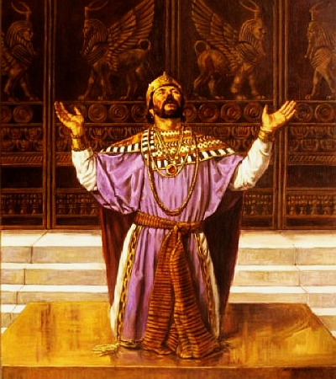
“Against You, You Only, Have I Sinned...
Isn’t it interesting what is not in Psalm 51?
David had committed adultery, lied, manipulated, and murdered.
Yet, in his classic psalm of confession, not one of those sins is specifically identified.
Neither Bathsheba nor Uriah is named.
Why is that?
Because David’s transgressions were serious symptoms of the greatest ailment of all—not treasuring God above every other person, pleasure, and thing.
I know my transgressions,
and my sin is ever before me.
Against you, you only, have I sinned
and done what is evil in your sight.
Create in me a clean heart, O God,
and renew a right spirit within me.
Cast me not away from your presence,
and take not your Holy Spirit from me.
Restore to me the joy of your salvation,
and uphold me with a willing spirit.

Slide 12
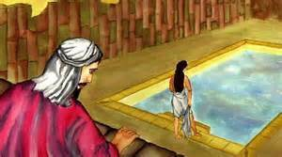
Against You, You Only, Have I Sinned...
David’s sin did not stem from ignorance.
David’s shortcoming was not the result of a long-held, deep-seated disagreement with the laws of God.
He was a man after God’s own heart!
But on that night, David wanted illicit sexual gratification more than he wanted God.
In the days that followed, David guarded his sinful secret more than he guarded his covenant with God.
When the situation grew desperate, David feared the awful truth being revealed more than he feared God.
When backed into a corner, David demonstrated more of a willingness to shed innocent blood than to honestly and penitently cast himself before the feet of the God who already knew what David had done.
David was exactly right when he confessed, “I have sinned against the LORD” (2 Sam 12:13).

Slide 13

The Personal Side of Temptation
The same is true for us.
The body is not meant for sexual immorality, but for the Lord, and the Lord for the body. (1 Cor 6:13)
Put on the Lord Jesus Christ, and make no provision for the flesh, to gratify its desires. (Rom 13:14)
God has not called us for impurity, but in holiness. Therefore whoever disregards this, disregards not man but God, who gives his Holy Spirit to you. (1 Thes 4:7-8)

Slide 14

The Personal Side of Temptation
Every day we are faced with decisions, opportunities, tests, and trials.
We know what God has said, but will we supplement our knowledge with integrity?
We know what God expects, but will we fortify Biblical truth with personal character?
We hear preaching about righteousness, self-control and the coming judgment on Sundays, but will we reinforce the facts with faith on Mondays?

Slide 15
The Personal Side of Temptation
Are the blessings that flow from your connection with God more gratifying than the sinful images that can flow through your connection to the Internet? That is the question! If not, you can so easily find yourself enslaved to pornography.
Late at night, when everyone else is in bed, is the urge to pray stronger than the tugs of sin on the garment of your flesh? If not, sin can so easily seize an opportunity to deceive you.
“Blessed are the pure in heart, for they shall see God” (Matt 5:8). Does that blessed assurance of seeing God mean more to you in the moment than self-centered, self-gratifying immorality? If not, you will continue to do the very thing you hate (Rom 7:15).

Slide 16
The Personal Side of Temptation
Until he treasures God as more precious than pornography, he will continue to be in bondage to pornography.
Until she cherishes God as more satisfying than the lying and the gossip, she will continue to be enslaved to sins of the tongue.
Until the pain of being separated from God is greater than the pain of repentance, he will not give up the adultery.

Slide 17
Psalm 34
The angel of the LORD encamps
around those who fear him, and delivers them.
Oh, taste and see that the LORD is good!
Blessed is the man who takes refuge in him!
Oh, fear the LORD, you his saints,
for those who fear him have no lack!
The young lions suffer want and hunger;
but those who seek the LORD lack no good thing.
Come, O children, listen to me;
I will teach you the fear of the LORD.
What man is there who desires life
and loves many days, that he may see good?
Keep your tongue from evil
and your lips from speaking deceit.
Turn away from evil and do good;
seek peace and pursue it.
I will bless the LORD at all times;
his praise shall continually be in my mouth.
My soul makes its boast in the LORD;
let the humble hear and be glad.
Oh, magnify the LORD with me,
and let us exalt his name together!
I sought the LORD, and he answered me
and delivered me from all my fears.
Those who look to him are radiant,
and their faces shall never be ashamed.
This poor man cried, and the LORD heard him
and saved him out of all his troubles.

Slide 18
Psalm 34 Continued
The eyes of the LORD are toward the righteous
and his ears toward their cry.
The face of the LORD is against those who do evil,
to cut off the memory of them from the earth.
When the righteous cry for help, the LORD hears
and delivers them out of all their troubles.
The LORD is near to the brokenhearted
and saves the crushed in spirit.
Many are the afflictions of the righteous,
but the LORD delivers him out of them all.
He keeps all his bones;
not one of them is broken.
Affliction will slay the wicked,
and those who hate the righteous will be c condemned.
The LORD redeems the life of his servants;
none of those who take refuge in him will be condemned.

Slide 19

God’s Personal Invitation and Challenge
In the moment of temptation, which taste buds will you gratify? The seductively-engraved invitation of illicit indulgence entices you to taste and see. But remember,
The lips of a forbidden woman drip honey,
and her speech is smoother than oil,
but in the end she is bitter as wormwood,
sharp as a two-edged sword. (Prov 5:3-4)

Slide 20
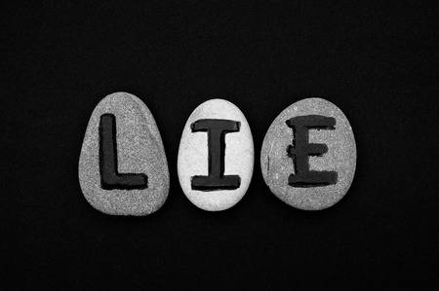
God’s Personal Invitation and Challenge
How desperately we must tell ourselves in the moment of trial, “You are being told a lie!
There is a sweeter alternative. There is a superior satisfaction!”
Oh taste and see that the LORD is good!
Blessed is the man who takes refuge in him!
Oh, fear the LORD, you his saints,
for those who fear him have no lack!
The young lions suffer want and hunger;
but those who seek the LORD lack no good thing.

Slide 21
God’s Personal Invitation and Challenge
God invites us to delight in him.
Savor him.
Crave more than bits of intellectual knowledge about Him.
Fearfully avoid the temptation to confine Him to the margins of your life.
Refuse to act as though you can use Him in whatever ways you choose and whenever you find it convenient.
Taste and see that the LORD is good!

Slide 22
God’s Personal Invitation and Challenge
How refreshing and liberating are the words of David in Psalm 63:1-3:
O God, you are my God; earnestly I seek you;
my soul thirsts for you;
my flesh faints for you,
as in a dry and weary land where there is no water.
So I have looked upon you in the sanctuary,
beholding your power and glory.
Because your steadfast love is better than life,
my lips will praise you.

Slide 23

God’s Personal Invitation and Challenge
An intimate relationship with God is better than the highest illicit high.
Purposeful communion with him is more enjoyable than any earthly gratification.
A consistent walk with him is more thrilling than any fleeting deviance.
His refining fellowship is more exhilarating than anything this world will ever offer.
Forsake the mirages and flee to him!

Slide 24
God’s Personal Invitation and Challenge
Respond to his compassionate call in Psalm 81:13-16:
“Oh, that my people would listen to me,
that Israel would walk in my ways!
I would soon subdue their enemies
and turn my hand against their foes.
Those who hate the LORD would cringe toward him,
and their fate would last forever.
But he would feed you with the finest of the wheat,
and with honey from the rock I would satisfy you.”

Slide 25
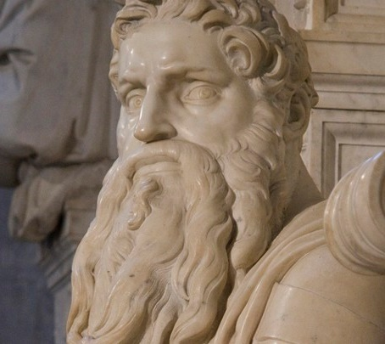
God’s Personal Invitation and Challenge
Sin will continue to promise gratification, but it is lying to you. It is lying to me. Oh, how it lies to us!
Confront your temptations and conquer them with the superior satisfaction which flows only from a deep, rich, intimate connection with God.
Make your prayer the prayer of Moses in Psalm 90:12-14:
So teach us to number our days
that we may get a heart of wisdom.
Return, O Lord! How long?
Have pity on your servants!
Satisfy us in the morning with your steadfast love,
that we may rejoice and be glad all our days.

Slide 26
God’s Personal Invitation and Challenge
Temptations will come, but let them come. God is more powerful. God is more satisfying.
No temptation has overtaken you that is not common to man. God is faithful, and he will not let you be tempted beyond your ability, but with the temptation he will also provide the way of escape, that you may be able to endure it. (1 Cor 10:13)

Slide 27
God’s Personal Invitation and Challenge
Follow in the footsteps of Joseph and refuse the horrible trades.
Do whatever you must every day to develop eyes that recognize how small and shriveled and worm-infested the fruits of temptation are.
Remind yourself every day how bright and expansive the orchard of God is.
There are acres of fruit waiting for us.
Miles of rows of opportunities to be at peace and serve and surrender and conform to a God who gives and gives and gives.

